Slide 1
Crop Production Analysis in India
Created By
Harshita Choubey

Slide 2
Objectives
Create visually appealing and interactive views and dashboards using the provided dataset on crop production in India.
Identify key indicators and metrics that significantly influence crop production, such as weather patterns, soil quality, irrigation methods, crop varieties, and market demand.
Develop a compelling narrative or storyline that connects the data insights and predictions with real-world implications for stakeholders in the agriculture sector.

Slide 3
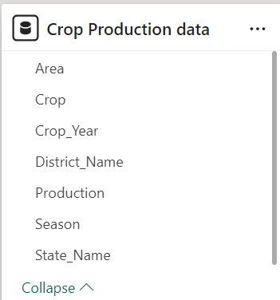
Details of Dataset
The dataset spans from 1997 to 2015 and covers total crop production data for various seasons across districts and states in India. It includes information on multiple crops, offering a comprehensive view of agricultural output over nearly two decades. This dataset enables detailed analysis of production trends, regional variations, and the impact of seasonal factors on India's agricultural sector.

Slide 4
Main KPIs
Crop Name
Production
Year
Season

Slide 5
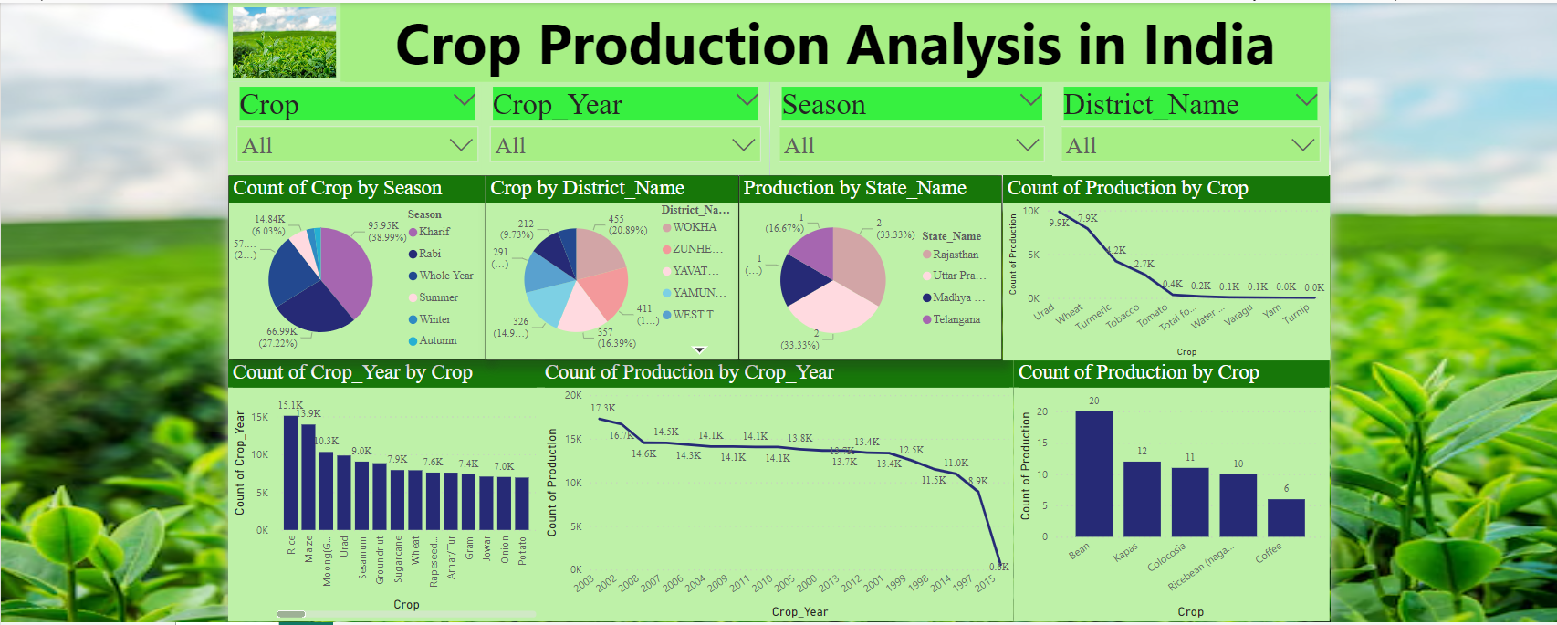
My Design

Slide 6
Thankyou

